Slide 1
NERVENET
LEARNING STRUCTURED POLICY WITH
GRAPH NEURAL NETWORKS
Reporter : Jingtian
Date: 2019/11/6
Advisor: Dr.Wang

Slide 2
Outline
Review 1: Reinforcement Learning
Review 2: Graph Neural Network
Background 1: Structured Policy
Background 2: Structure Transfer Learning
Method : NerveNet
Experiments
How to build a graph
Notes:
first, to understand this application, I will introduce some relative works.

Slide 3
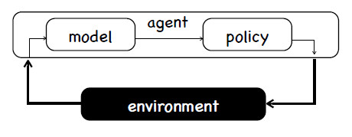
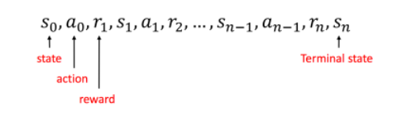
Review 1: Reinforcement Learning
Deep Reinforcement Learning
Notes:
The learning task of reinforcement learning (RL) is agent learning policy: that is to say, for the observation or state given by the external environment, an ideal action is given (the "ideal" definition is often defined by reward function). After learning, a complex decision-making process can be carried out. Moreover, learning is sequential,

Slide 4
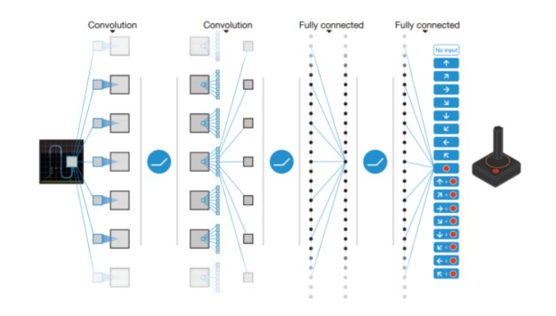
Review 1: Reinforcement Learning
Notes:
input is state
output is probability of action

Slide 5
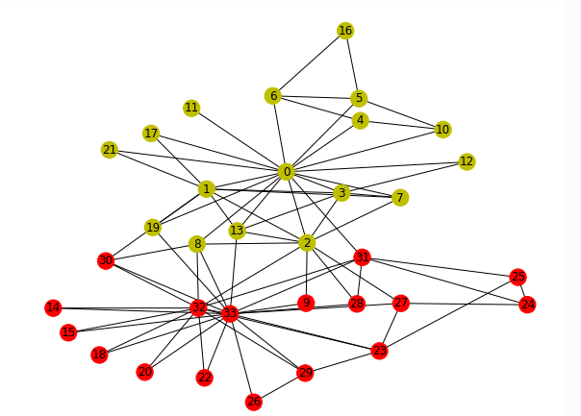
Review 2: Graph Neural Network
DGL https://docs.dgl.ai/install/index.html
Graph Deep Learning framework
Problem description
“Zachary’s karate club” problem
The club later divides into two
communities led by the instructor
(node 0) and the club president
(node 33)
Task
The task is to predict which side
(0 or 33) each member tends
to join given the social network itself
Notes:
Let’s talk about the graph neural network.
DGL is an open source for Graph Deep Learning framework .
now , I will give you a real question to know the GNN’s work.

Slide 6
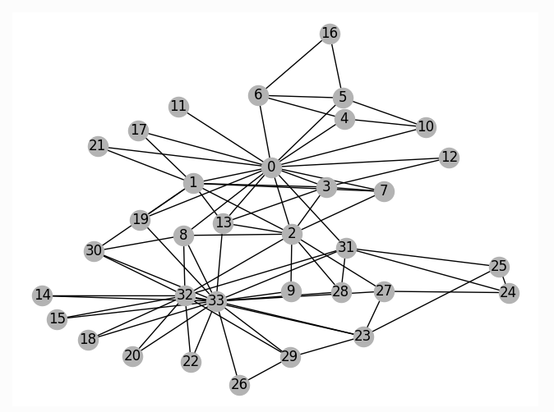
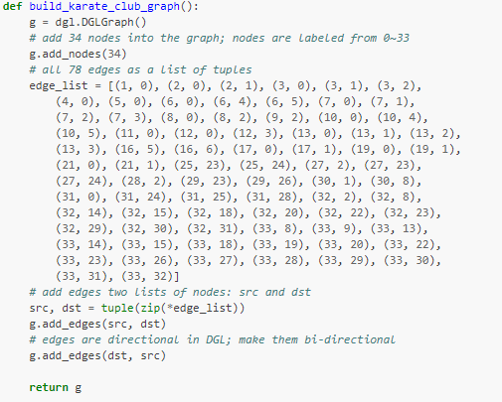
Review 2: Graph Neural Network
1.init graph
Notes:
it’s a directional graph,

Slide 7
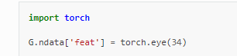
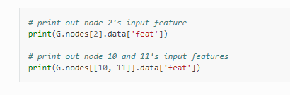
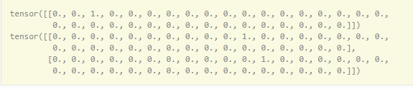
Review 2: Graph Neural Network
2.add feature vector

Slide 8
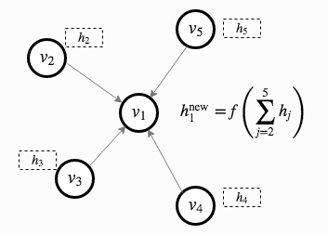
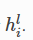
Review 2: Graph Neural Network
3. GCN process
1.At layer , each node carries a feature vector .
2.Each layer of the GCN tries to aggregate the features from where are neighborhood nodes to into the next layer representation at . This is followed by an affine transformation with some non-linearity.
Notes:
At layer ll, each node vlivil carries a feature vector hlihil.
Each layer of the GCN tries to aggregate the features from uliuil where uiui‘s are neighborhood nodes to vv into the next layer representation at vl+1ivil+1. This is followed by an affine transformation with some non-linearity.

Slide 9
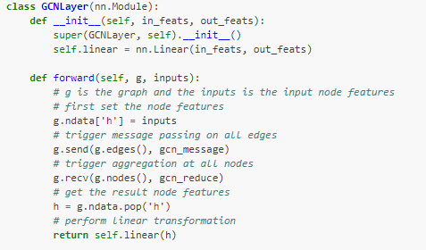
Review 2: Graph Neural Network

Slide 10
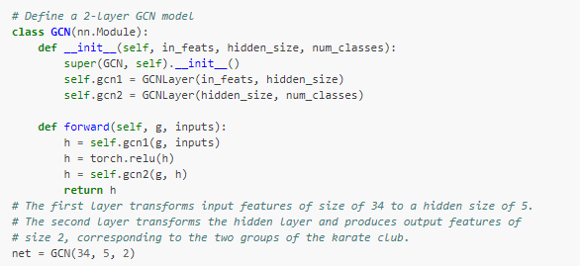
Review 2: Graph Neural Network

Slide 11
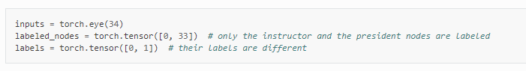
Review 2: Graph Neural Network
4.Data preparation
We use one-hot vectors to initialize the node features. Since this is a semi-supervised setting, only the instructor (node 0) and the club president (node 33) are assigned labels. The implementation is available as follow.

Slide 12
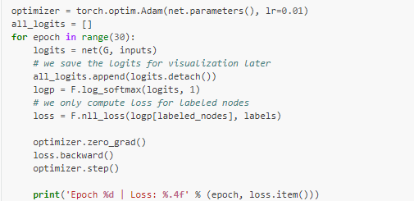
Review 2: Graph Neural Network
5. Train
Notes:
This is a rather toy example, so it does not even have a validation or test set. Instead, Since the model produces an output feature of size 2 for each node, we can visualize by plotting the output feature in a 2D space. The following code animates the training process from initial guess (where the nodes are not classified correctly at all) to the end (where the nodes are linearly separable).

Slide 13
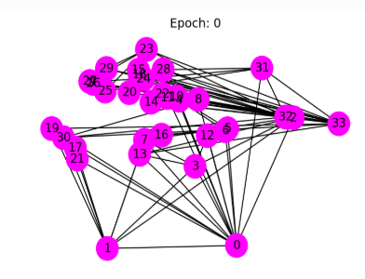
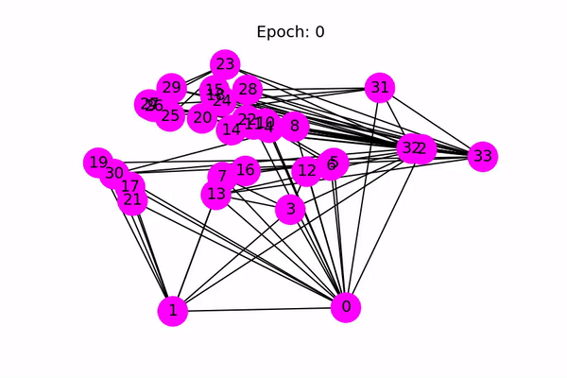
Review 2: Graph Neural Network

Slide 14
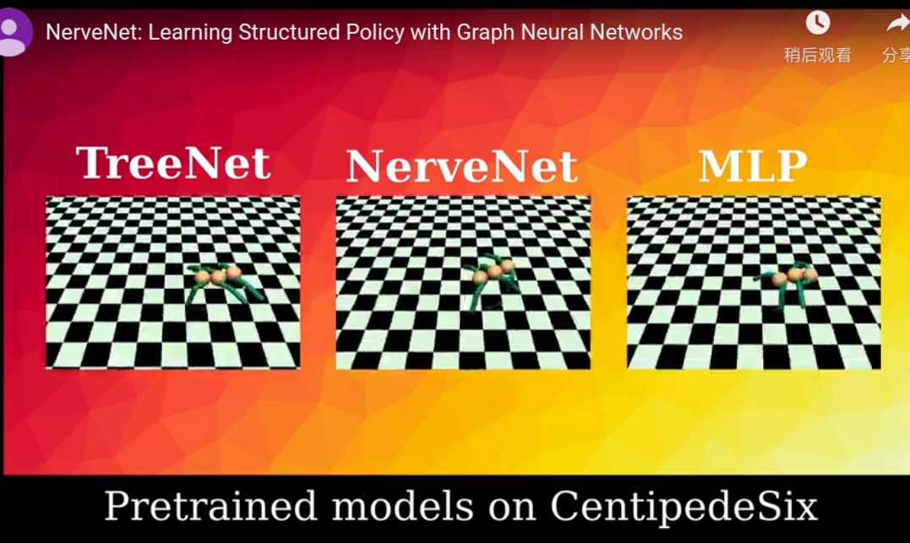
Background 1: Structured Policy
Learn to walk by a great structured body moving way.
Notes:
How to walk well

Slide 15
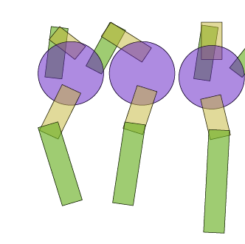
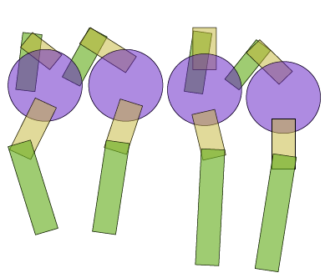
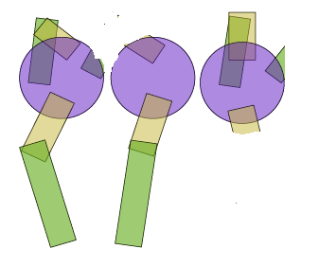
Background 2: Structure Transfer Learning
Size transfer
size transfer focuses on the scenario in which policies are learned for small-sized agents (simpler body structure) and applied directly to large-sized agents which are composed by some repetitive components shared with the small-sized agent.
Disability transfer
disability transfer investigates scenarios in which policies are learned for one agent and applied to the same agent with some components disabled.
Notes:
[səˈnærioʊ]

Slide 16
NerveNet :
Compared with tradition
Traditional Reinforcement Learning
1.Policies of agents are learned by MLP
2.concatenation of all observations
GNN Reinforcement Learning
1.Policies of agents are learned by GNN
2.each node has its own observations
Notes:
Introduce a lot of things, lets’ talk about how to do a reinforcement learning by using graph NN

Slide 17
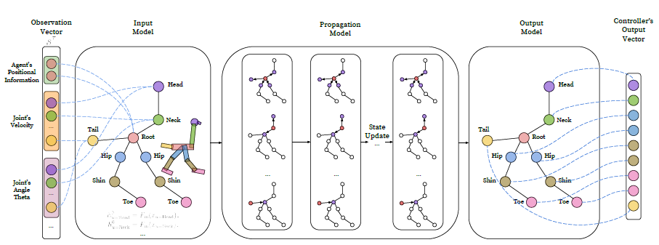
Paper Aim: http://www.cs.toronto.edu/~tingwuwang/nervenet.html
exploit the body structure of an agent, and physical dependencies that naturally exist in such agents.
Notes:
ostrich

Slide 18
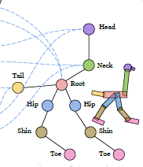
Presentation
bodies of most robots and animals
have a discrete graph structure.
Nodes of the graph may represent
the joints, and edges represent the
(physical) dependencies between
them

Slide 19
Notation
State space
Action space
Policy
Reward

Slide 20
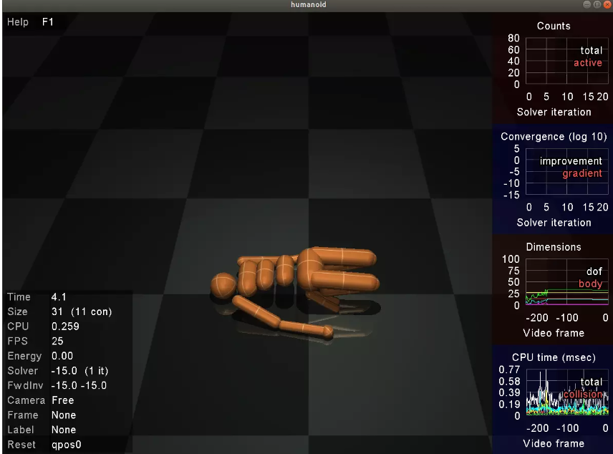
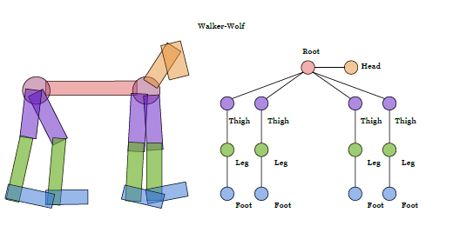
Graph Construction
Tool : MuJoCo
Three types of nodes:
body: for example : Thigh Shin
joint : for example: knee
root : has access to the target position of the agent.
Notes:
穆约科
[θaɪ]
[ʃɪn]
Take a simple humanoid as an example; the body nodes Thigh and Shin are connected via
the Knee, where Knee is a hinge joint.

Slide 21
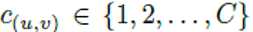
NerveNet as Policy Network :
Notation:
graph structure of agent:
V and E are the sets of nodes and edges, respectively
out-going neighborhood of node
all out-going neighborhood of node :
node type like body, joint, root
edge type
the time step in the environment
propagation step
Notes:
Node type can help in capturing different importances across nodes. Edge type can be used to describe different relationships between nodes, and thus propagate information between them differently.
One can also add more than one edge type to the same edge which results in a multi-graph.

Slide 22
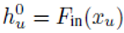
Graph Construction : 1.Input Model
For each time step in the environment, the agent receives an observation
the elements of observation vector corresponding to node
with
superscript : propagation step
subscript : the node index
F : may be a MLP
Notes:
subscript and superscript denote the node index and propagation step .

Slide 23
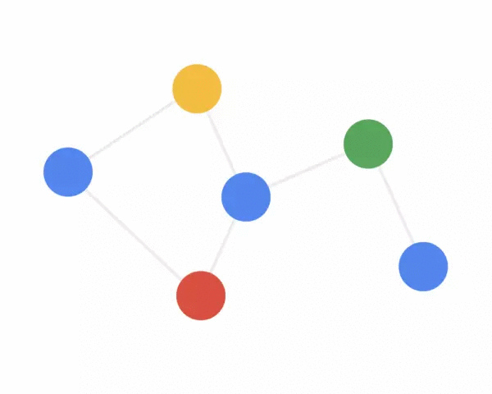


Graph Construction : 2. Propagation Model
Message Computation
compute (do message)
send
Message Aggregation
receive
non-linear transform
States Update

Slide 24
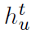
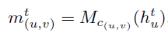
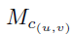
Graph Construction : 2. Propagation Model
Message Computation
step t every node u , we have a state vector , and every out edge, node u computes a message vector:
each c(u,v) is a type of edge, which is mapping into different
function or MPL.
In this paper , they use MLP to compute the messages which uses tanh nonlinearities as the activation function

Slide 25
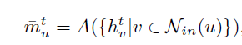
Graph Construction : 2. Propagation Model
Message Aggregation
Once every node finishes computing messages, we aggregate messages sent from all in-coming neighbors of each node
A is the aggregation function which may be a summation, average or max-pooling function.
is the aggregated message vector which contains the information sent from the node’s neighborhood
Notes:
for every node u, we perform the following aggregation:
A is the aggregation function which may be a summation, average or max-pooling function.

Slide 26
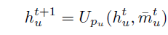
Graph Construction : 2. Propagation Model
States Update
U is the update function which may be a gated recurrent unit (GRU), a long short term memory (LSTM) unit or a MLP
same type nodes use same function.
The above propagation model is then recurrently applied for a fixed number of time steps T to get the final state vectors of all nodes.
Notes:
We now update every node’s state vector based on both the aggregated message
and its current state vector.

Slide 27
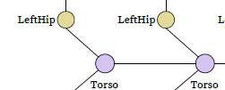
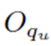
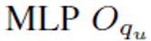
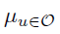
Graph Construction : 3. Output Model
In RL, agents typically use a MLP policy, where the network outputs the mean of the Gaussian distribution for each of the actions.
make predictions for each individual node.
Different sharing schemes are available for the instance
of
two LeftHip nodes have a shared controller
：the mean value for action applied on each actuator
Notes:
mean means the most possible Q-value

Slide 28
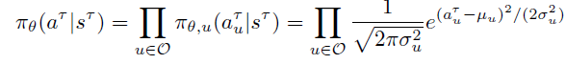
Graph Construction :3. Output Model
unified function
force controllers of different output types to share one unified controller
Notes:
怎样求得的a 和 segma

Slide 29
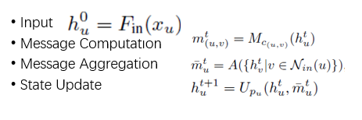
Summarization to get policy
each individual node
one unified controller

Slide 30
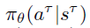
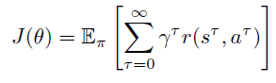
4. Learning Process
policy:
reward:
next state :
The target of the agent is to maximize its cumulative return
action
Notes:
after agent get the policy , agent do the action of the policy, so the agent get reward, and the state of the environment change, then, the agent predict the next policy, and do while.
so we will get a long term reward, and our target is to maximize the long term reward.

Slide 31
Experiments: STRUCTURE TRANSFER LEARNING
on standard MuJoCo environments in OpenAI Gym
Agent ： Centipede（蜈蚣）
Reward：For each time step, the total reward is the speed reward minus the energy cost and force feedback from the ground
reward = speed – energycost – forcefeedback
Observation:
For the joint nodes, angular velocity and twist angle force are common observations . Optionally the torque(转矩) for the hinge joint, and position information for the positional joint
For the body nodes, velocity, inertia(惯性), and force are common observations

Slide 32
Experiments: STRUCTURE TRANSFER LEARNING
Model: Centipede2 Centipede4 Centipede8 Centipede16
Extra Task:
size transfer: Centipede8 is difficult to train
4 to 6 6 to 10
disability transfer: Cripple Centipede

Slide 33
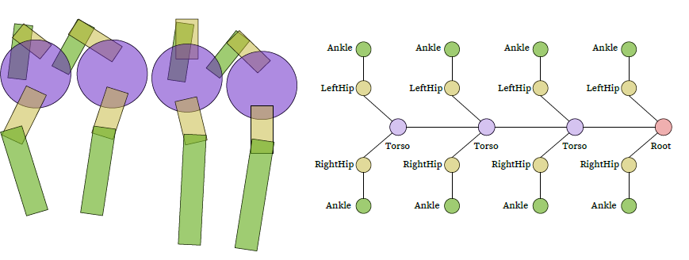
CentipedeEight

Slide 34
NerveNet

Slide 35
NerveNet’s ability
In transfer:
NerveNet: repetitive structure, reuse the weights of the corresponding joints from the small-agent mode
other MLP based model : reuse the weights from the first hidden layer to the output layer and randomly initialize the weights of the new input layer.
MLP Activation Assigning (MLPAA): not add or remove any layers, changing the size of the layers
Notes:
For the NerveNet, since all the weights are exactly the same for the small and the large agent models, we directly use the old weights trained on the small-agent model . When the large agent has repetitive structure, we further re-use the weights of the corresponding joints from the small-agent model.
reuse the weights from the first hidden layer to the output layer and randomly
initialize the weights of the new input layer

Slide 36
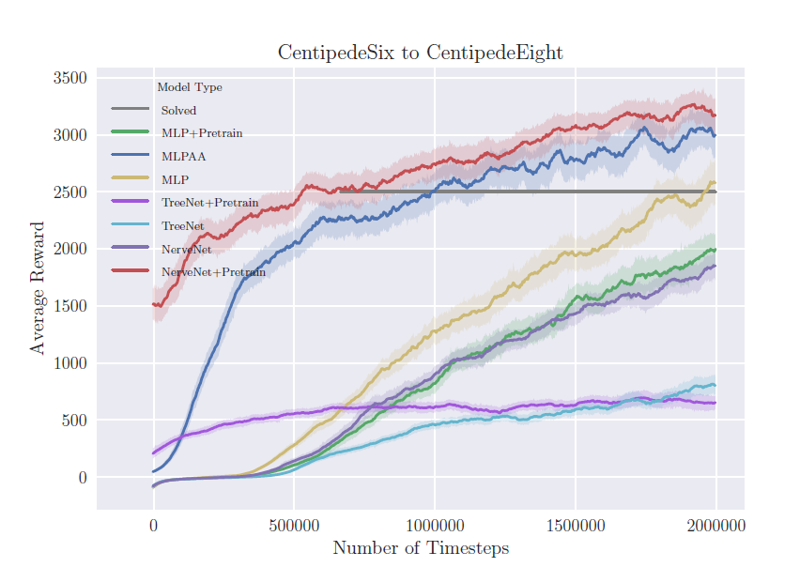
Results of fine-tuning for size transfer experiments
Notes:
transfer pretrain nervenet get the best reward ,and MLPAA get the second. The graph structure has a high transfer ability.

Slide 37
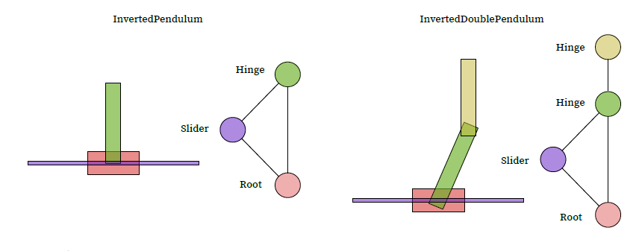
How to build a graph

Slide 38
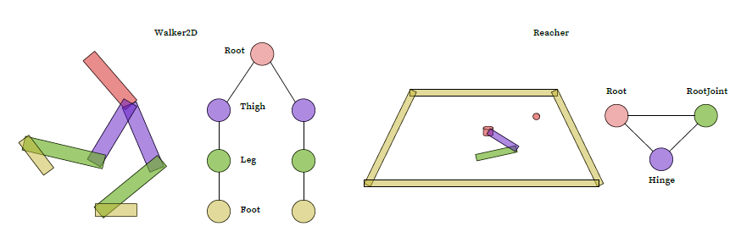
How to build a graph

Slide 39
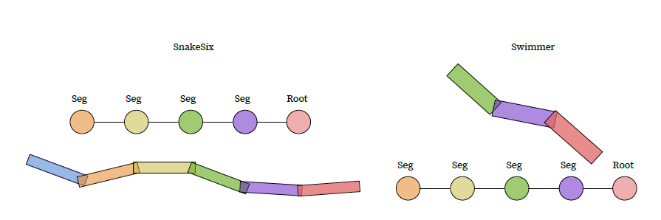
How to build a graph

Slide 40
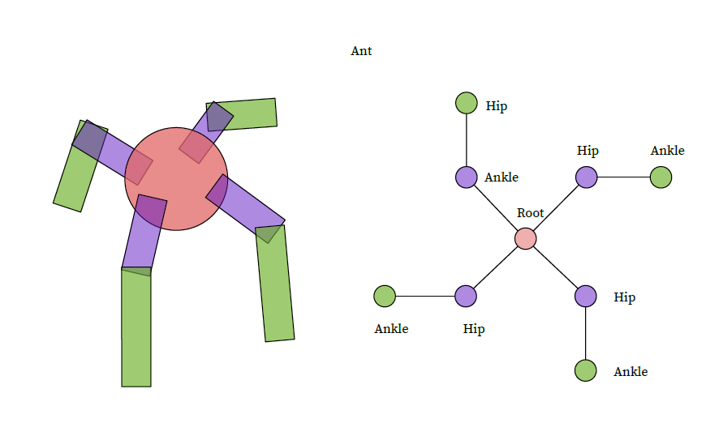
How to build a graph

Slide 41
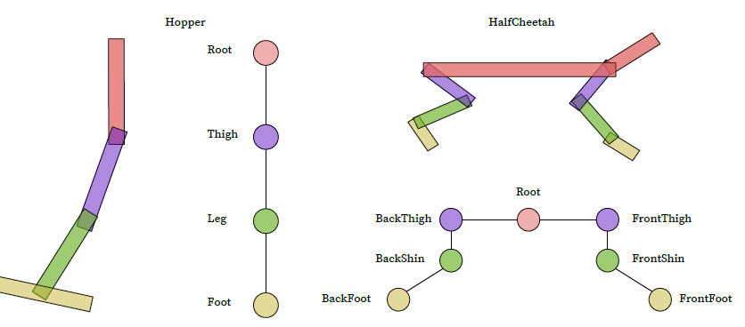
How to build a graph

Slide 42
How to build a graph

Slide 43
Reference
《NERVENET: LEARNING STRUCTURED POLICY WITH GRAPH NEURAL NETWORKS》 TingwuWang, Renjie Liao, Jimmy Ba & Sanja Fidler
http://www.cs.toronto.edu/~tingwuwang/nervenet.html
DGL graph 框架 https://docs.dgl.ai/tutorials/basics/1_first.html
《Playing Atari with Deep Reinforcement Learning》

